Slide 1
NutriScope
Team Task Titans:
Jayesh Pamnani
Manav Gupta
Bhanu Teja Panguluri
Will Dzialak
Kunal Haryani

Slide 2
Project Management Life Cycle
Monitoring/Controlling
Testing RACI
Testing Resource Histogram
Planning
Scope
Setup
WBS
Milestones
Risk Analysis
Communications Plan
Cost Model
Initiation
Project Vision
MOVs
Execution
Quality Standards
Stakeholder Management
Closure*
Issue Log
Goals Met
Final Report
*Project has not yet reached the closure phase
Project Management Life Cycle

Slide 3

PROJECT VISION
What is NutriScope?
Comprehensive health metrics tracking application
Key Features
Tracks steps, calories, heart rate
Meal photo calorie estimation
Seamless device integration
Graphical health trend analysis
Differentiator
Empowers informed decisions
Combines multiple metrics & advanced features
Why NutriScope?
Achieve fitness goals with holistic tracking
Actionable insights for better health
User-friendly interface for daily use

Slide 4
MOVs
User Adoption Rate
100,000 daily active users by the end of the second year
Engagement Metrics
25% increase in user engagement within the first year
Health Improvement
10% improvement in all key health metrics for all users after the third year
Retention Rate
75% on a month-to-month basis
Integration Success
Increase of 5% in integrated wearable devices until a reasonable expected maximum is reached

Slide 5
MILESTONES
Creation of a Prototype
Initial Deployment
S: Deploy across all platforms
A: DevOps team assigned
R: Feasible after all testing
T: 1 year from start
S: Evolutionary Prototype
M: 5 s to identify calorie info
A: BE does API, FE does UI
R: Creation feasible
T: 3 months from start
M: Handle 100k users

Slide 6
SCOPE
Project Justification
Addressing demand for comprehensive health tracking
Empowering users with personalized recommendations
Aligning with health management trends
Product Characteristics
User-friendly interface
Personalized health profiles
Manual and automatic activity tracking
AI-powered meal photo calorie estimation
Visual health trend representation
Goal setting and tracking
Reminders and notifications
Data privacy and security measures
Summary of Deliverables
Project management documents
Requirements, design, and testing documentation
Mobile app codebase
Backend infrastructure
Third-party API integration
User manuals and training materials
Deployment and maintenance guides

Slide 7
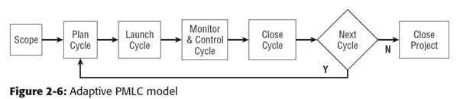
PROJECT SETUP
Conditions of Satisfactions (COS):
Request: Multi-platform Fitness app with data security and calorie estimation.
Clarification: Android, iOS, wearOS, watchOS, web app with end-to-end encryption and ML calorie estimation.
Response: Well tested app with AES-256 encryption using a FoodAPI and ML model.
Agreement: Feedback and assistance from stakeholders, and any changes to be accepted based on resource availability.
Project Management Life Cycle Model:
Adaptive PMLC chosen for NutriScope. Reasons:
Changing Requirements: Scope changes expected.
Stakeholder Engagement: Stakeholders agree to actively engage with project.
Evaluation: Want to discover failures and successes early on.

Slide 8
QUALITY STANDARDS
01
06
Load Capacity
(Scalability to Handle Many Users)
Accessibility Compliance
(Comply with Guidelines)
02
07
User Interface Responsiveness
(Seamless User Experience)
User Satisfaction Rate
(Meet or Exceed Expectations)
03
System Uptime and Reliability
(Reliable and Low Disruption)
08
Feature Completeness
(Fully Functional at Launch)
04
Data Encryption and Security Standards
(Security and Protect User Data)
09
Regulatory Compliance
(Compliance with Regulations)
05
Error Rate
(Low for all Functionality)
10
Software Update Frequency
(New Features, Address Issues, etc.)

Slide 9
RISK ANALYSIS
Negative Risk:
Data Privacy Breach: Data leaked due to security failures.
Positive Risk:
High User Adoption Rate: Unexpected rise in users stresses the infrastructure, increases cost, and decreases performance.
Risk Mitigations:
Data Privacy Breach: Cybersecurity strategy, powerful encryption, IDS, and security audits. Cultivate a security awareness culture.
High User Adoption Rate: Creation of a scalable architecture, optimized DB, server elasticity, and CRM to manage users.
Risk Analysis

Slide 10
STAKEHOLDER MANAGEMENT
Multiple strategies used throughout the project life cycle including:
Structured Feedback Sessions
Trainings/Workshops
Use of Collaborative Tools (Slack, Microsoft Teams, etc.)
Creation of a Communication Management Plan
KEYS TO SUCCESS
Being open to change and criticism
Regularly providing updates
Minimizing risk by planning ahead and budgeting
Good communication between team members and those with a need-to-know

Slide 11
COMMUNICATIONS PLAN
Requirements
Summary
Guidelines
Weekly status report to steering committee
Daily updates & immediate alerts to project team
Regular updates to IT for system requirements & support issues
Bi-weekly updates to HR
Monthly feedback to user groups
PM generates status report for steering committee
All team members share updates
HR Liaison creates HR updates
PM organizes meeting with User Groups
Tech Lead generates IT support requests
Respecting Time: Communications are concise
Encouraged Feedback: Stakeholders provide feedback
Confidentiality: All sensitive information is confidential and shared with relevant stakeholders
Communications Plan

Slide 12
TESTING
What does this include?
Unit tests
A Balanced Approach
Testing team with different personalities and perspectives
Consists of project team members and potential users
Testing Occurrence
Iterative process where tests occur during and after execution
Success of the tests is necessary for final approval and product deployment
Acceptance tests (does the product satisfy business requirements?)
Integration and functional tests
Performance tests

Slide 13
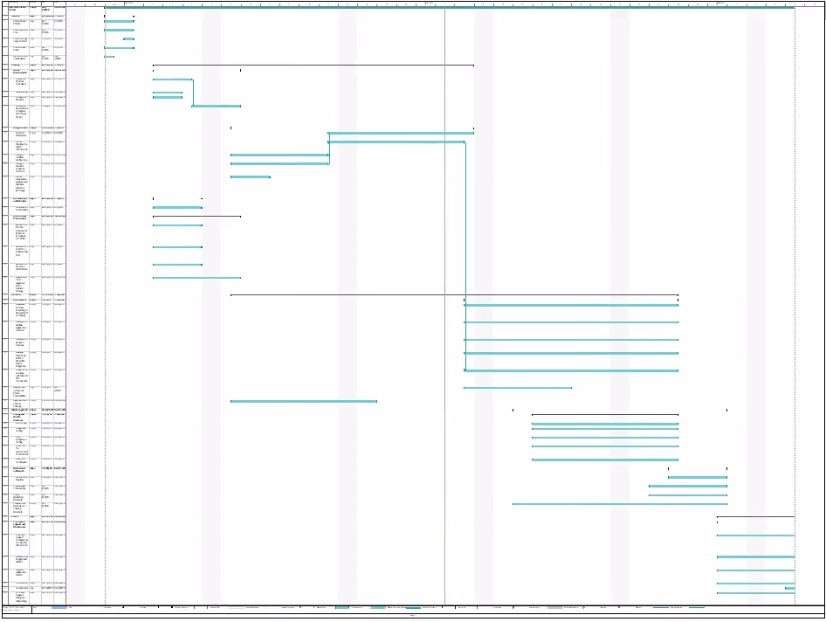
Work Breakdown Structure (WBS)
Tasks were organized by our PMLC stages: Initiation, Planning, Execution, Monitoring/Controlling, and Closure These tasks included creating a business case, performing market analysis, designing a modular codebase, performing security audits, and many more

Slide 14
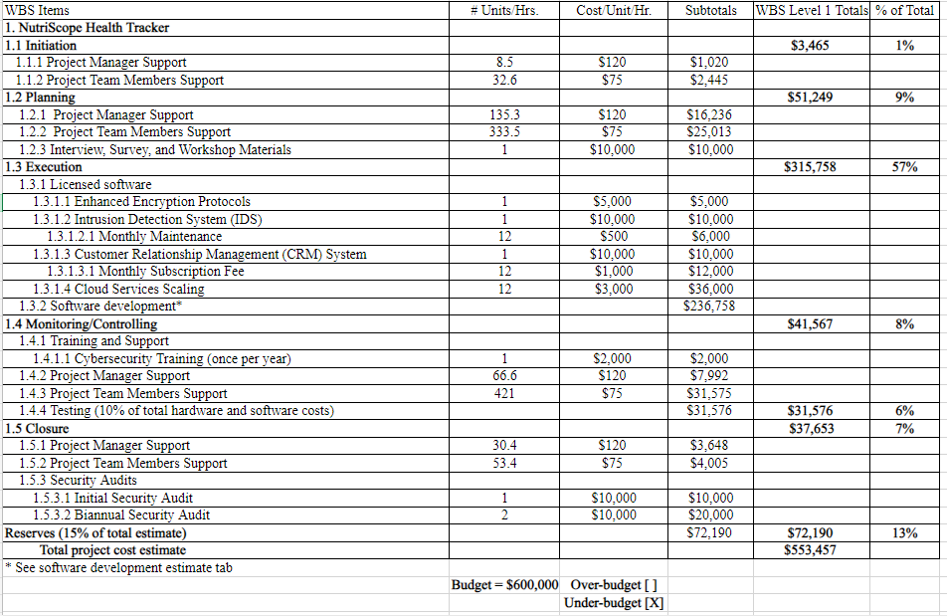
Cost Model
Spreadsheet used to keep track of known expenses including employee wages, audits, materials and resources, etc. Aligns with the WBS in terms of the projected amount of work (more tasks within a phase, especially those of longer duration, will add to the overall cost) *Budget had to be increased

Slide 15


Q&A

